Slide 1
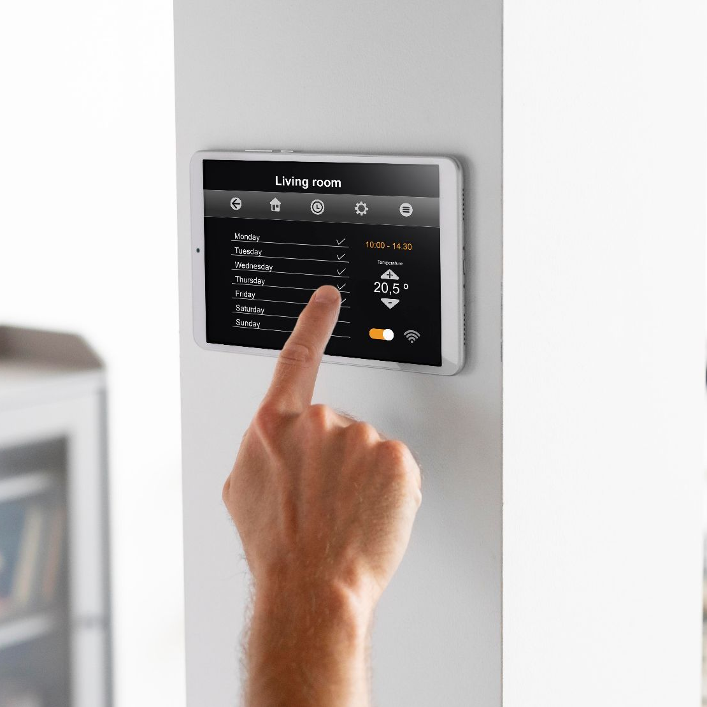
IoT System Development and Data Analysis
Zahra Alwaili

Slide 2
Introduction
Forecasting Challenge
Methodology
Utilized the Jena Climate Dataset
Advanced feature engineering with 24h+ lags.
Time-aware cross-validation (TimeSeriesSplit).
Hyperparameter optimization using Optuna.
Comparison of Boosting (XGBoost, LightGBM) vs Linear baselines.
The primary goal is to predict Air Temperature (TdegC) 24 hours into the future
The solution requires a leakage-safe pipeline ensuring that no future information is visible to the model during training or feature engineering.

Slide 3
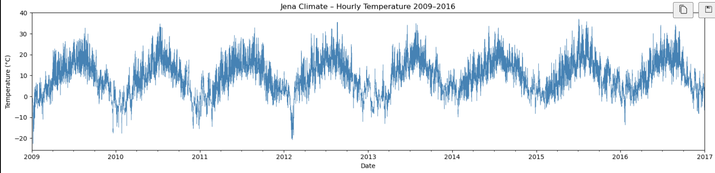
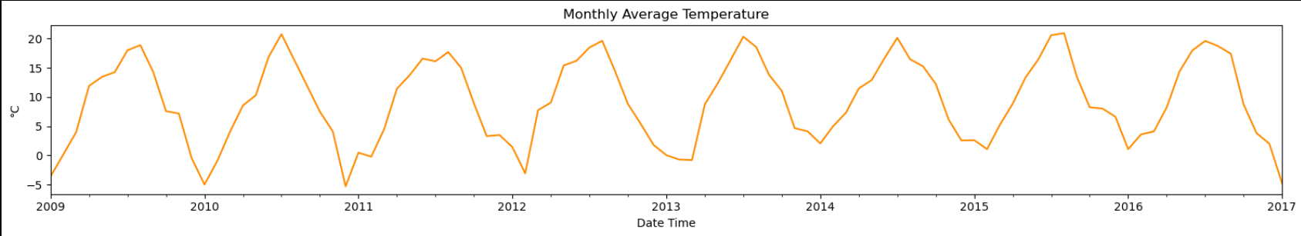
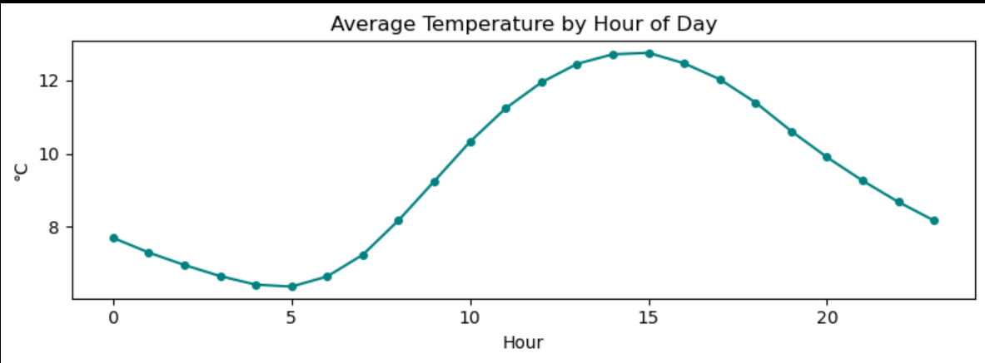
Data Exploration
Notes:
Initial analysis shows clear daily and annual seasonality. Data was resampled from 10-minute intervals to hourly averages to reduce noise while maintaining temporal fidelity.
Observation: Temperature exhibits
significant autocorrelation, especially
at 24-hour intervals, which will be
leveraged for feature lags.

Slide 4
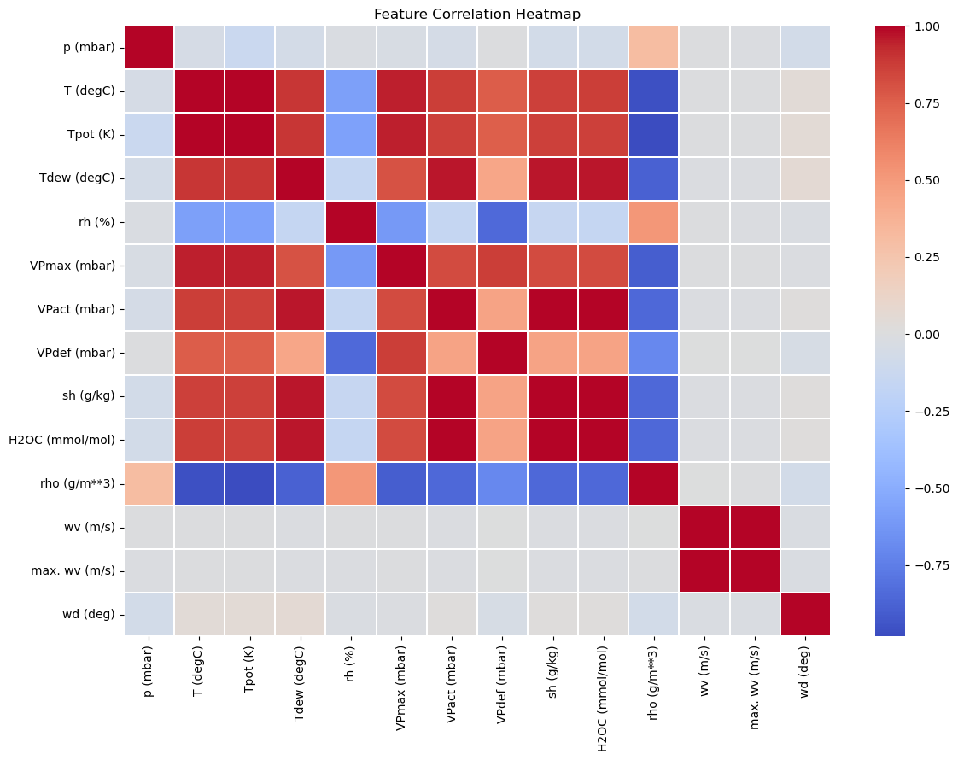

Slide 5
Feature Engineering
Rolling Statistics
Cyclical Encoding
Lag Features
Created 24h, 48h, and 168h lags for temperature and pressure to capture historical dependencies.
Engineered rolling means and standard deviations over 24h windows to provide local context.
Encoded hour and month using sine/cosine transforms to preserve their cyclical nature.

Slide 6
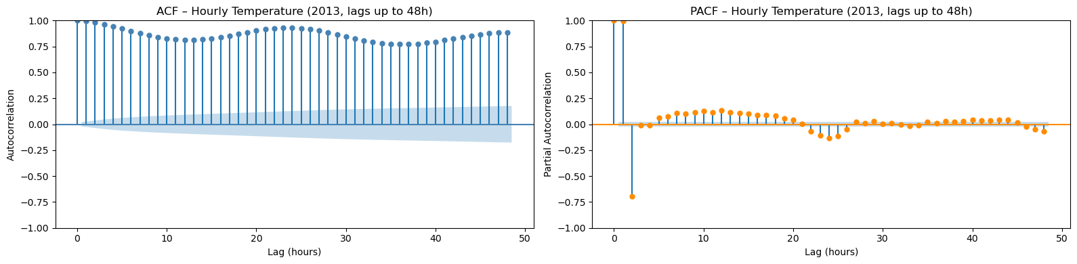
Annual Seasonality
Daily Temperature Fluctuations

Slide 7
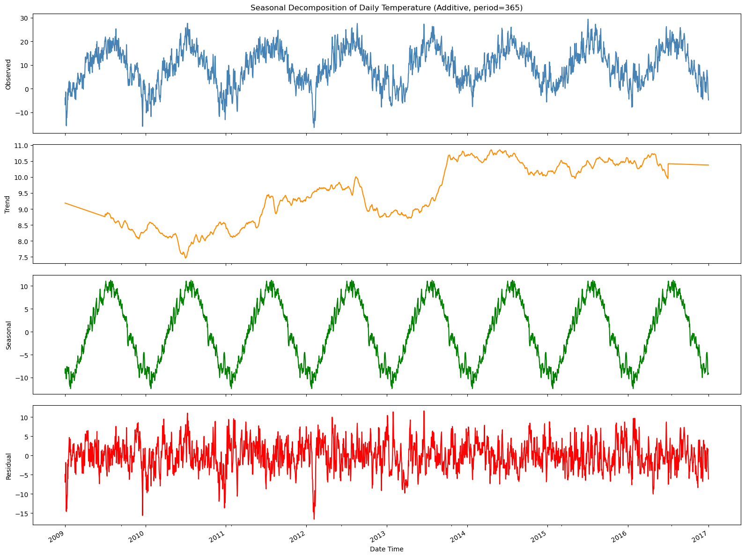
Seasonal and ACF Analysis
Notes:
Additive seasonal decomposition reveals a dominant 24-hour cycle. The trend component shows long-term annual fluctuations.
Stationarity checks and Autocorrelation (ACF) confirm strong periodicities at 24h and 48h lags, validating our use of long-term lags as high-value predictors.

Slide 8
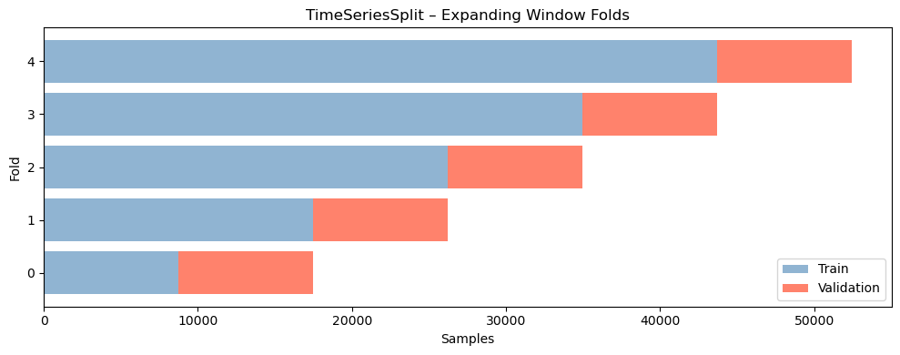
Model Validation
The dataset is split by using TimeSeriesSplit to prevent data leakage
This ensures the model is always trained on the past and validated on the "future," simulating real-world deployment performance.
Notes:
Traditional random CV is unsuitable for time series. We implemented a 5-fold TimeSeriesSplit with an expanding window.
This ensures the model is always trained on the past and validated on the "future," simulating real-world deployment performance.
IMP NOTE: MENTION STANDARDSCALER AS WELL – ‘it is not mentioned here but Standard Scaler is also used to……’

Slide 9
Models
Ridge Regression: A linear regression model with L2 regularization. This model is used as a baseline for our dataset.
Random Forest: A bagging ensemble algorithm that uses multiple decision trees in parallel. This model was used as a benchmark to check whether the system requires a more complex model to predict the unforeseen data.
LightGBM: A gradient boosting algorithm that grows tree leaf-wise than level-wise. They can map patterns with high frequency and are also able to capture complex patterns much faster and with greater detail than normal tree structures.
XGBoost: An advanced gradient boosting algorithm that builds trees sequentially to minimize residual errors. They can detect sharp fluctuations in datasets, which proves useful if there are sudden drastic changes.

Slide 10
Baseline Benchmarking
4.382
RMSE Baseline
3.438
MAE Baseline
0.6996
R² Baseline
Notes:
Utilized Persistence baseline where T(t+24) is predicted as T(t).
Our advanced ML models aim to minimize this error significantly by capturing complex non-linear meteorological interactions.

Slide 11
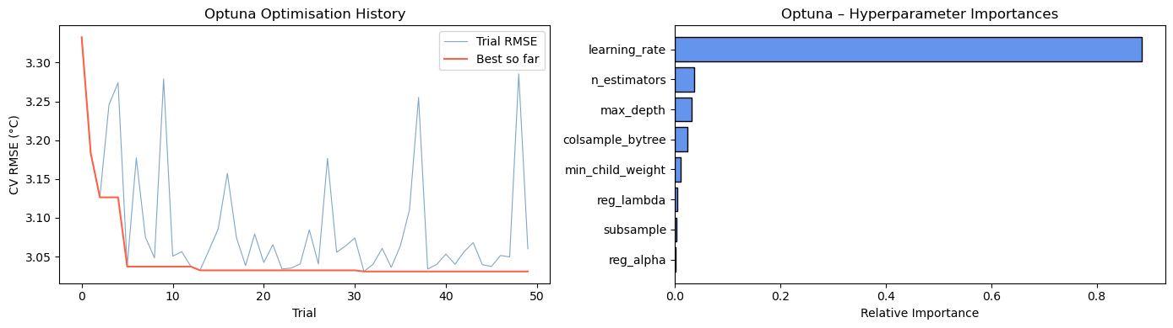
Hyperparameter Tuning
Tool used: Optuna with Tree-structured Parzen Estimator (TPE) sampler to search for optimal boosting parameters
Notes:
Optuna with Tree-structured Parzen Estimator (TPE) sampler to search for optimal boosting parameters. After 50 trials, the search significantly lowered the CV RMSE, finding the perfect balance between max_depth, learning rate, and regularization (Alpha/Lambda).

Slide 12
Results
MODEL | RMSE AND MAE | R²
Ridge Regression | RMSE: 5.296 MAE: 2.470 | 0.5613
Random Forest | RMSE: 3.000 MAE: 2.356 | 0.8592
LightGBM | RMSE: 2.926 MAE: 2.305 | 0.8661
XGBoost | RMSE: 2.959 MAE: 2.323 | 0.8630

Slide 13
Conclusion
Winning Model: LightGBM was the top performer with an RMSE of 2.926, outperforming the baseline by over 33%.
Key Drivers: Advanced feature engineering and Optuna optimization were essential to capture complex climate patterns.
Outcome: Built a robust, leakage-safe pipeline ready for high-accuracy temperature forecasting in IoT applications.
Future Improvement: Model accuracy could be further enhanced by implementing deep learning like LSTMs or adding other environmental factors like wind direction and humidity.
Notes:
Based on our results, LightGBM emerged as the superior model, achieving a 2.926 RMSE and significantly outperforming the persistence baseline by over 33%. The integration of advanced feature engineering and Optuna optimization proved essential in capturing the complex daily and annual patterns of the Jena Climate dataset. Ultimately, this project establishes a robust, leakage-safe pipeline for high-accuracy temperature forecasting in IoT applications.

Slide 14
THANK YOU!
Any Questions?

